Slide 1
New Life for Community Urban Destitute Support project progress to date
Adama, Sept 24, 2021

Slide 2
Presentation out line
Background of New Life for Community
To date accomplishment
Profile of Urban Destitute Support project
Project Objective
Beneficiary category
Scope of the Services
Strategies
Expected outcome
Key performance indicators
Conclusion

Slide 3
Background
New Life for Community (NLC) is a local Non–governmental organization initiated by individuals of good will with the support of five volunteers.
It was established in 2004 and registered under charity and societies Agency in 2005 at federal level in Ethiopia.
NLC encourages and supports people to improve their personal, social and economic wellbeing.
NLC works closely with the communities and the local government structures.
Currently the NLC encompasses two administrative zones these are; east shoa zone-Adama City and Jimma zone-Jimma town and Agaro village through expanding the organizational programs.

Slide 4
Vision of the NLC
To see transformed society that is able to take responsibility and accountability for their social and economic well being.

Slide 5
Overall goal of the NLC
To contribute to integral human development through ensuring the socio economic well-being of the society in Social & Development works.

Slide 6
Targeted beneficiaries
Since its establishment NLC had involved on different humanitarian and development services
This includes support for street children and people with disabilities
Support of elderly people and families in extreme poverty
Support for unemployed youth
Support of prisoners
Engaged on ensuring gender equality and women empowerment

Slide 7
Previous accomplishment with regard to UDSP
Provided awareness for the community and parents of street children and children with disabilities
NLC had received 5o street children in to the rehabilitation center under Urban Destitute Support Project
Provided Psychosocial, education and health services to the target beneficiaries
Provided seed money as revolving fund for IGA
Some of them attended vocational training and employed
Some of the street children were Reintegrated and reunified with their parents

Slide 8
Types of service provided
Outreach services to children on the street
Temporary shelter of full time, i.e., with sleeping facilities;
Temporary home services such as lockers, meals, etc.
Health and hygiene services (showers, toilets, basic health care, etc.)
Sport, cultural, artistic and play activities

Slide 9
Conti…
Life skills training as per the life skill training development guideline and modules .
Educational and training services
Counselling services /social and psychological support
Health services including health education
Family reunification and support as per the family reunification guideline

Slide 10
Psychosocial support provided
All children received a psychosocial assessment as part of their intake process
Based on the assessment and as per the counseling guideline provided individual and group counseling and therapeutic services
Provided life skill training as per the assessment guideline
Conducted health education
Arrange non-formal(focused on literacy and numeracy) and formal education
Arranged and organized play, sport, art & cultural activities

Slide 11
Exit Strategy
There are four possible long-term solutions:
Family reunification
Foster care
Institutional care
Employed by attending vocational training

Slide 12
Exit strategy
S.No | Types of exit | Number
1 | Family Reunification | 9
2 | Employed by attending vocational training | 27
3 | Children rejoined education | 8
4 | Works on taxi | 6
 | Total | 50

Slide 13
Few Pictures which indicate previous accomplishment

Slide 14
Shaved their hair

Slide 15
The Children in dining room

Slide 16
When they were entered in the rehabilitation center

Slide 17
Physical exercise

Slide 18
Street Children addressed in First round

Slide 19
Part of the street children who attended training and employed in Bekas Chemicals factory

Slide 20
Urban Destitute Support Project
Donor World Bank through MoLSA
Project target Street Children and Adults
The newly enrolled beneficiaries 235
160 youth and Adults age between 19-59
75 Children age 14-18
Project duration 1 year and six months
Target area Adama town

Slide 21
Objective of the Project
The objective of the Urban Destitute Support (UDS) sub-component is to improve the economic, educational and social reintegration of the homeless through providing basic social and livelihood services.

Slide 22
Beneficiary Category
Homeless adults are defined as men or women aged 18-59 and with no children with them in the street.
Homeless children 14-18
If they have children or are over 59 years old, they will be covered under a different category.
It can be expected that many of these homeless adults have a mental or physical disability.

Slide 23
Scope of Services to be provided
Temporary shelter, with sleeping facilities
Temporary home services such as lockers, meals, etc.
Health and hygiene services (showers, toilets, basic health care, etc.)
Specialized health care and support for physical and mental disability
Cash transfers and/or as start-up capital for income generating activities

Slide 24
Services
Educational and training services, including literacy, life skills training and vocational training,
Counseling services/ social and psychological support
Employment services (including employment counseling, technical assistance, start-up capital, and follow-up)
This may include direct service provision as well as referral to other institution’s services.
However, preference will be given to service providers able to offer a combination of services that address a comprehensive set of needs

Slide 25
Services
In subsequent contacts side by side holding discussion with the target homeless people, different kinds of services like:
health education,
counseling and group guidance services,
life skill training and
other handouts (as long as the budget allows) will be provided.

Slide 26
Strategies
The service provided is ‘individualistic’ and ‘pluralistic’ approaches in providing psycho-social support, specialized health services, education and training, employment services and counseling services.
Individualistic approach in this context implies that services will be rendered for every single client independently as per his or her needs (c/management).
The pluralistic approach, on the other hand, is the way of providing a given set of services to groups of clients depending on their needs and groups based on certain characteristics (e.g. age, sex).

Slide 27
Implementation life Span
The project life span is a total of 18 Months. Duration of stay in temporary shelters could range from 3 months to 6 months for physical, social and psychological rehabilitation.
Rehabilitation will be followed by a 12-month project supported social, economic or educational reintegration into the society.
The service will be regularly monitored by MoLSA/BoLSA in collaboration with city administrations.
Additionally, a performance evaluation will be carried out at the end of 9 months to monitor whether services are being provided as per the specified norms and standards.

Slide 28
Activities accomplished to date
Renting and preparation of Rehabilitation center
Conducted First and Subsequent Contacts with potential target people
The first contact took place in the areas/sites where these target homeless people are living and spending the night
The message being delivered or communicated to the homeless people during the first contact was short and precise to identify their willingness

Slide 29
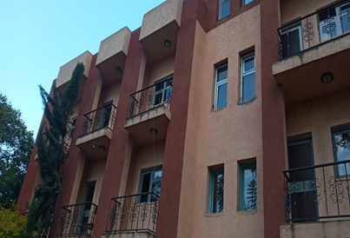
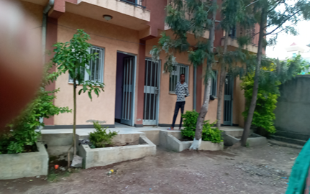
Rehabilitation Center

Slide 30
Contact at their living area on the street

Slide 31
Other areas used for target contact
At Drop-in center(rehabilitation center of the service provider);
At the yards or halls in religious institutions( churches and mosques);
Offices of community based organizations (office of Iddirs preferable);
Woreda/Kebele offices(youths hall at woreda is preferred); or
Other convenient places including camps

Slide 32
Beneficiary screening and enrollment

Slide 33
Beneficiary screening and enrollment

Slide 34
Beneficiary profile
During screening the following information were taken from them

Slide 35
Conti…
After discussion with nominee beneficiaries they Engaged on planting seedling of green legacy
Screened and welcomed to the center
Provided with bed sheet, blanket, pajamas pillow and mattress)
Their hair Shaved by recruiting barber
Medical check up service was given to them
Health services were provided for those who were sick
Provided with Psychosocial counseling

Slide 36
They engaged on green legacy

Slide 37
Conti…

Slide 39
Conti…

Slide 40
Conducted project launch
The project was launched at the presence of representative from MoLSA, BoLSA, Adama town OLSA, Religious leaders, volunteers from Ministry of peace, individuals, private sectors and respective beneficiaries
The vision, mission and to date accomplishment of the Organization was presented
Objective of the UDS project
Service packages
Strategies
Performance indicators were discussed

Slide 41
Participants on project launch
S.No | Participants | Male | Female | Total
1 | MoLSA | 1 | 0 | 1
2 | BoLSA | 7 | 0 | 7
3 | Adama Municipality | 1 | 1 | 2
4 | Adama University | 1 | 0 | 1
5 | Harambe university | 1 | 0 | 1
6 | Adama town OLSA | 3 | 1 | 4
7 | Volunteers | 12 | 8 | 20
8 | Adama WYCAffair | 0 | 1 | 1
9 | Media | 4 | 0 | 4
10 | Evangelical fellowship | 3 | 1 | 4
11 | Other religious leaders | 5 | 0 | 5
 | Total |  |  | 48

Slide 42
Participants of the project launch

Slide 43
While leading the discussion after presentation

Slide 44
Distribution of Clothing, mattress and night wear

Slide 45
Conti…

Slide 46
After wearing the clothing in the center

Slide 47
Under 18 beneficiaries

Slide 48
Conti…

Slide 49
Nutritional support
In the temporary rehabilitation center (shelter) the other principal services provided for the target beneficiaries was nutritional support (feeding).
In addition to the above mentioned services nutritious meals were provided with variation to the homeless people enrolled in the center on regular basis by adapting to the targets caloric needs.
The menu of daily meal for breakfast, lunch and dinner was posted at visible position.
The center employed chef/cook and provided food services three times a day.

Slide 50
Health care services
Health Support is one of the service packages to be provided to the beneficiaries
Accordingly, the medical check up, treatment of sick individuals and referral linkage of cases with health problem the clinic in the Rehabilitation Center
Medical check up was conducted for the beneficiaries by deployed par-time medical doctor in addition to routine health monitoring
Provide personal hygiene kit that contains basic sanitary materials for target on regular bases
Availed sanitary materials and monitor cleanliness/personal hygiene of the target people

Slide 51
Conti…
Apart from routine medical and referral linkage a total of 42 beneficiaries were treated at eye clinic and forty of they were provided with eye glass and medication and the remaining two were referred to hospital.
A total of 9 beneficiaries were positive for COVID-19 and quarantined.
Out of them one case was admitted and attending treatment at Adama Hopital.

Slide 52
Conti…

Slide 53
Blood donation

Slide 54
Psychosocial support
Experienced professional was assigned as par time counselor of the beneficiaries
Assessment was done by spending time with the beneficiaries
Clients with stress, addiction and sign of depression were detected for counseling
Counselling services was provided to the beneficiaries depending on their status
The counseling services provided for a total of ______ individuals by psychologist

Slide 55
Cont…

Slide 56
Life skill training
Training was Given to the beneficiaries welcomed to the rehabilitation center
Attended training on life skill, SBCC, and emotional intelligence based on age category
14-18 Male 70 Female 5
19-24 A total of 26
25-34 A total of 105
35-59 A total of 29

Slide 57
Training Content
Facts about Teenagers and youth and their common behaviors
Core Life skill
Building Self esteem
Making wise and good decision
Effective Communication skills
Interpersonal relationship skills
Problem Solving skill
Critical thinking skill

Slide 58
Conti…
Empathy
Copping with stress and Emotion
Human Behavior
Peer Education to avert negative peer pressure
Living purposeful life

Slide 59
Life skill training

Slide 60
Conti….

Slide 61
Media and recreation
The beneficiaries were provided with media, edutainment, and recreation services on the planned schedule of their daily program in the rehabilitation center.
This has a healing effect of their psychosocial problems by enabling them to forget the previous unnecessary experiences and foresee bright future.
The media and edutainment services provided were arrangement of 52 inch television in the meeting hall, table tennis, and volleyball.

Slide 62
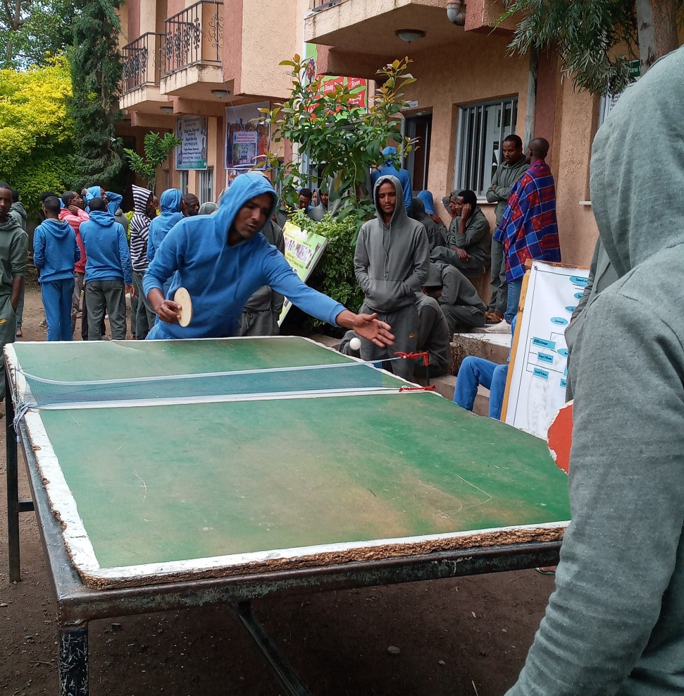
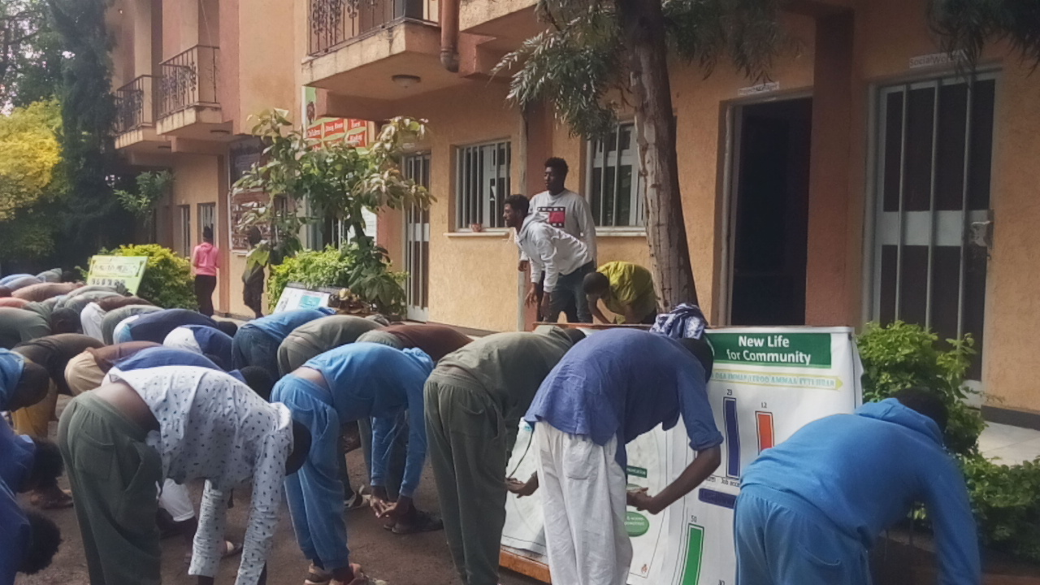
Beneficiaries involve on recreation

Slide 63
Reintegration
The primary aim of the Urban Destitute Support Project is rehabilitation and reintegration of homeless in to normal life
After receiving intended services packages in the rehabilitation center those who are in the normal condition and Psychologically prepared to start new life were screened
A total of _______ beneficiaries were identified for reunification and _______ of them were reunified
They were provided with _______ amount of money transferred to their account in order to generate income based on Entrepreneurship training they received

Slide 64
Entrepreneurship training
In order to sustain the project impact in the life of the beneficiaries the project has arranged vocational training to the beneficiaries based on their interests.
The beneficiaries were enquired to notify their area of interest for vocational training and they were enrolled on different areas such as barber, sewing clothes, driving licence, working in garages, pity trade, soap and detergent production, poultry farm and working on urban solid waste disposal.
Training was started in the rehabilitation center on sewing machine on tailoring and on barber. The skilled individual who can work as tailor and barber were also identified from among the beneficiaries in the vocational training.

Slide 65
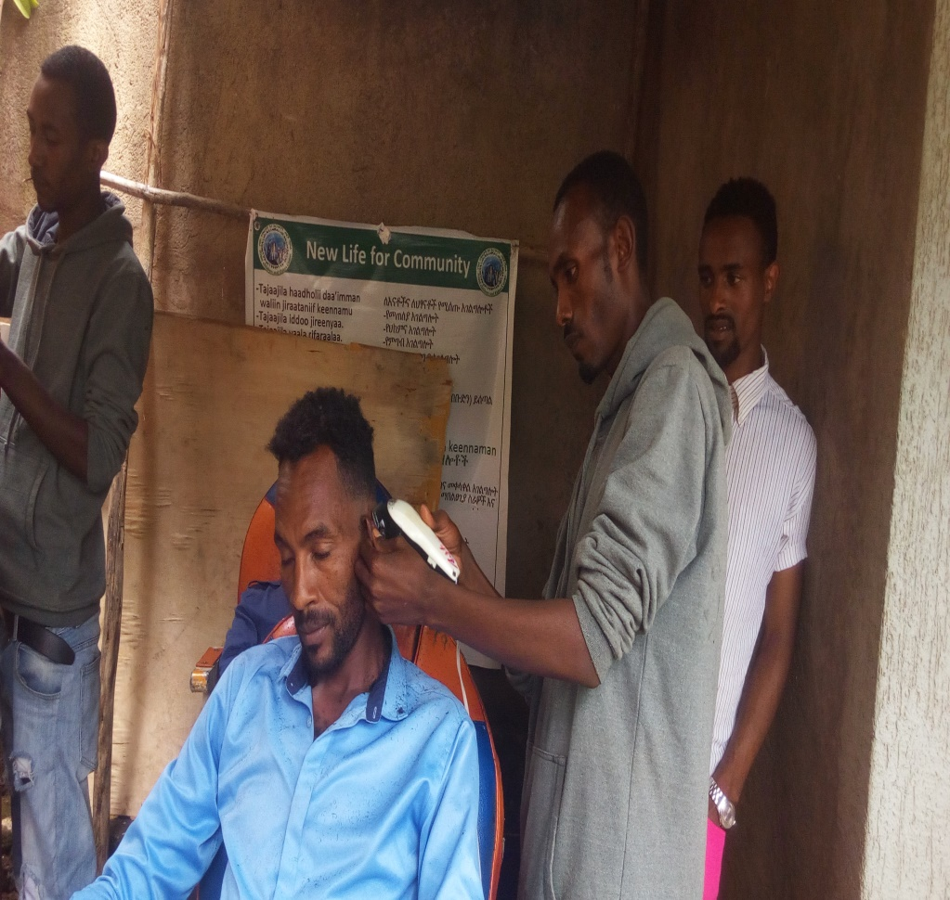
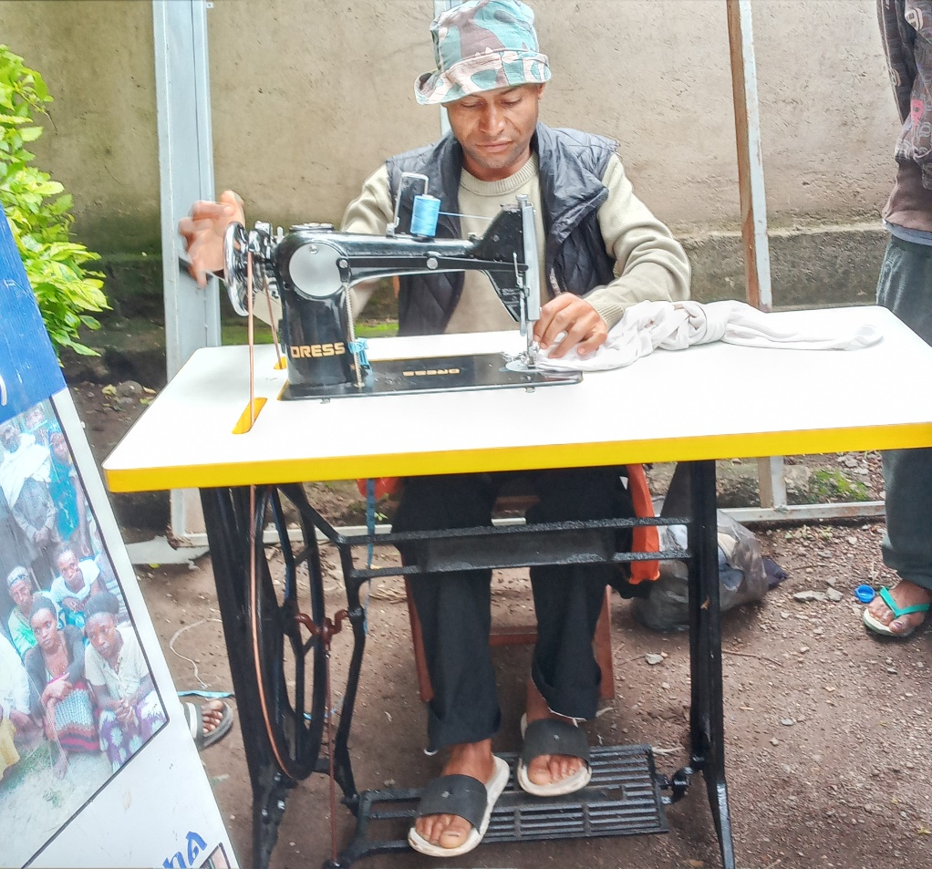
Conti…
Demonstration of hair cutting and sewing clothes in the R centre

Slide 66
Challenges
Price escalation and discrepancy of budget between the actual current market and the allocated one to afford food supply and other services packages to the expected standards
Over expectation of beneficiaries

Slide 67
Possible Solutions
In order to overcome the problem NLC tried to mobilize additional income for the center from different stakeholders; but none of them contributed what they had promised during the mobilization.
Detail explanation was given on the budget allocated to the beneficiaries at the presence of representative from Adama town Labor and Social Affairs.

Slide 68
Respective Stakeholders and collaborators
Ministry of Labor and Social Affair (MoLSA)
Bureau of Labour and Social Affair (BoLSA)
Ministry of Finance (MoF)
Bureau of Finance and economic cooperation (BFEC)
Office of labor and Social Affair (OLSA)
City Administration
FBOs and CBOs
Private Institutes and
Committed individuals

Slide 69
Conclusion
NLC will express deep gratitude for all the stakeholders and collaborators who supported us on every aspects
Separate strive brings little change but little effort in collaboration brings incredible change
We believe in partnership and welcome any one who is willing to join us to rescue generation

Slide 70
Galatoomaa!

